Slide 1


SPARK Interview Question Spark reduce VS fold

Slide 2

Spark : Reduce VS Fold
Reduce:
Commutative/associative property is assumed to be true
Combine the elements of the RDD together in parallel (e.g., sum) List(1,2,3).reduce{_ + _}
Fold:
same as reduce but needs an initial value .
Commutative property is assumed to be NOT present.
The initial value provided should be the identity element for your operation; that is, applying it multiple times with your function should not change.
List(1,2,3).fold(1){_ + _}

Slide 3
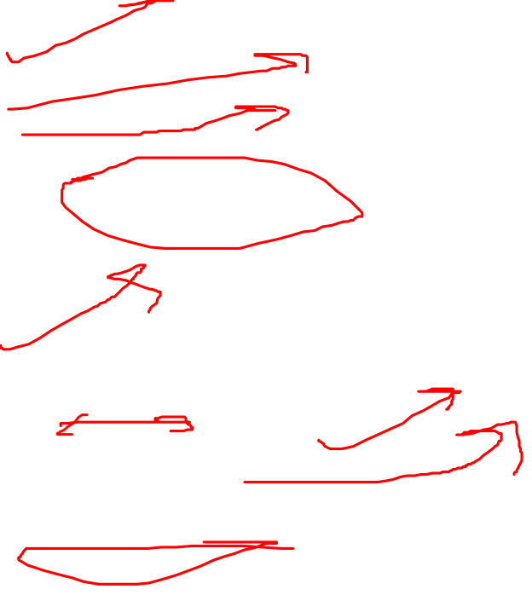
Spark : Reduce VS Fold
Fold like this:
In:
initial value
way to combine stuff with initial value
collection
Out:
combined stuff
And reduce is like this:
In:
way to combine stuff
collection
Out:
combined stuff

Slide 4

Spark : Reduce VS Fold
Fold needs "starting element" be provided, reduce will automatically take 1st element of sequence as starting, so they are kind of equivalent for some degree.
Reduce more compact, but with fold you have ability to provide different start element and change result of the operation.
Things will be more exciting and more favorable for fold when you will step out of simple arithmetic's to some more complex binary operations like Set + Int:
List(1,2,3,3,2,2,1).foldLeft(Set[Int]())(_ + _) // will produce Set(1, 2, 3)

Slide 5
Thanks and do subscribe to my channel

